Slide 1
Contracts
How do we create our library of functions?

Slide 2
your drive -> shared with me ->
open your $lastName $firstName Contract Library document
create a folder in your google drive called
"04 - Contracts"
put your worksheets into this new folder

Slide 3
typingPal assessment #2 next class

Slide 4
copy a screenshot to the clipboard
Cmd+Ctrl+Shift+4

Slide 5
computer screen coordinates
slightly different from math coordinates
(0,0)

Slide 6
Contracts Day 2
How do we create our library of functions?

Slide 7
procedures
open 4 web pages
Class website -> "04 - Contracts"
www.afsenyc.org/fda
WeScheme.org -> open "04 - Contracts"
2 Google Docs
Image Functions Challenge
Student Contracts Library

Slide 8
Review of computer screen coordinates
How are they slightly different from math coordinates?
(0,0)
x increases to the right
y increases going down

Slide 9
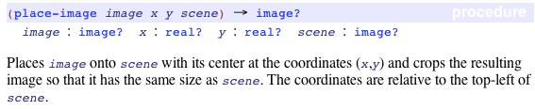
search the documentation for place-image
enter place-image into your contract library

Slide 10
what is a scene?
Enter the following code in wescheme:
(place-image
(circle 50 "solid" "red") 25 25
(rectangle 100 100 "solid" "blue"))

Slide 11
nested place-image functions
What is the domain of place image?

Slide 12
additional functions
you are required to learn these additional functions and enter them into your contract library
string-length
image-width
image-height
bitmap/url
rotate
scale
scale/xy
flip-vertical
flip-horizontal

Slide 13
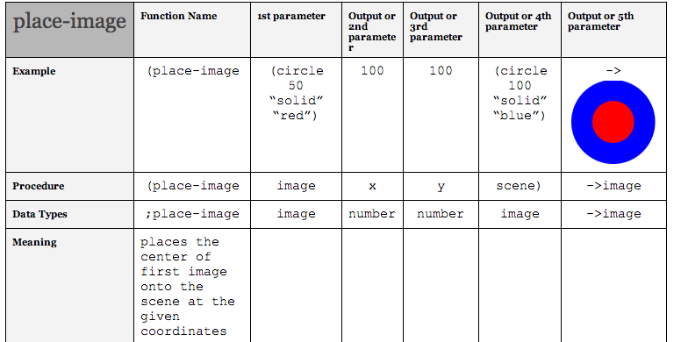
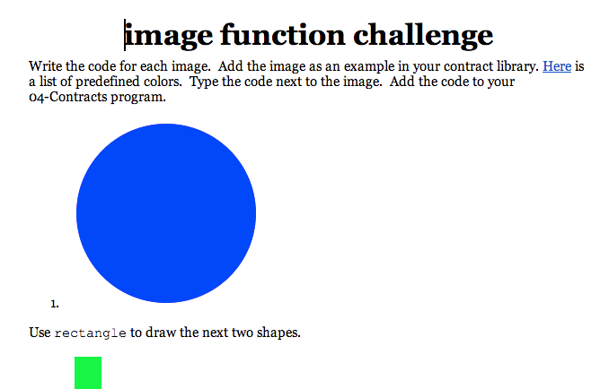
today's classwork
finish entering place-image and at least 2 other contracts
finish image functions challenge. Enter code into wescheme.org and submit.

Slide 14
typing pal assessment

